Slide 1
Parallel Graph Coloring: Implementation
Jeff Flower

Slide 2
Recap – basic graph definitions
A graph G = (V, E)
V is a set of vertices
E is a set of edges
Edge is defined by two vertices
vertex degree
The number of edges a vertex is an endpoint of
vertex adjacency
If 2 vertices share an edge, they are adjacent
[2]

Slide 3
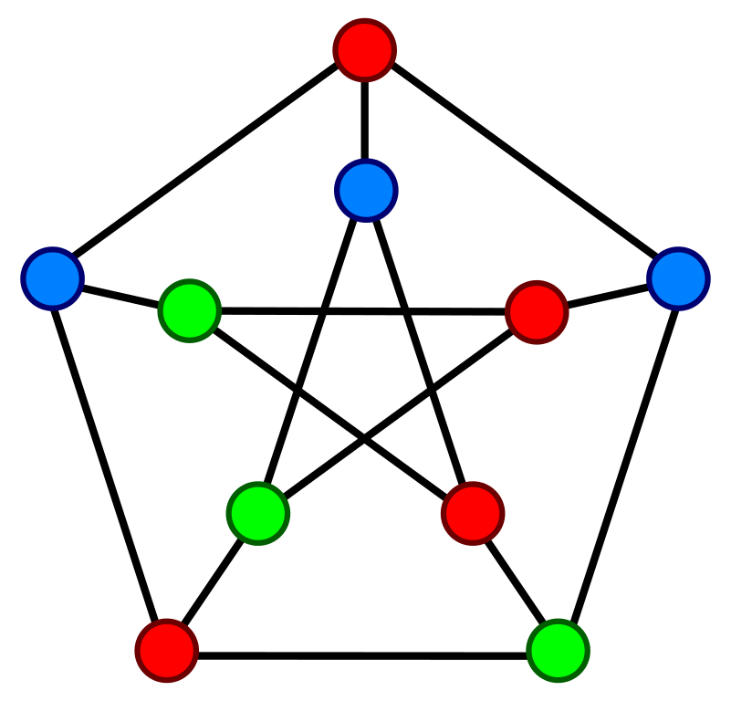
Recap – graph coloring
Graph coloring is the assignment of colors to each vertex
Labelling the vertices with a color name
A proper vertex coloring assigns colors to vertices such that no adjacent vertices use the same color [5]
Chromatic Number:
The minimum number of colors needed to properly color a graph
The picture on the right demonstrates a 3-coloring of the graph.
3 is also the chromatic number of the graph.
Importance of chromatic number depends on our goals

Slide 4
Graph Datasets
To test my program, I wanted to find some sample graph datasets.
The most popular source seems to be the Stanford Large Network Dataset Collection
http://snap.stanford.edu/data/index.html
These datasets are taken from real world data such as facebook friend circles, collaboration networks of physicists, etc…
The sets look promising, but I wanted to test my program with slightly smaller sets at first.
I found a collection of graph datasets through Penn State – Harrisburg that seemed the right size
https://turing.cs.hbg.psu.edu/txn131/graphcoloring.html

Slide 5
Representing Graphs in a Program
By it’s definition, a graph, G = (V, E). That is, G is made up of a set of vertices and a set of edges.
There are two ways to represent a graph in a program:
Adjacency Matrix
Adjacency List
Both of these methods have plusses and minuses. [2]

Slide 6
Adjacency Matrix
1 2 3
Pros: Given 2 edges, very easy to look up
Cons: Space, matrix size = (number of vertices)²
 | 1 | 2 | 3
1 | 0 | 1 | 0
2 | 1 | 0 | 1
3 | 0 | 1 | 0

Slide 7
Adjacency List
1 2 3
Pros: Use less space
Cons: Searching becomes cumbersome as the number of edges grows
1 = {2}
2 = {1, 3}
3 = {2}

Slide 8
Coloring Algorithm reminder
Block partitioning, proposed by Gebremedhin and Manne (2000) [1]
p = number of processors
n = number of vertices
Phase 1: Pseudocoloring
randomly partition vertices evenly among the p processors
Color each of the n/p vertices
Optional synchronization barrier at the end of each step so that graph information is up to date when we go to color the next vertex
Phase 2: Check for conflicts
Possible there are adjacent vertices using the same color, each processor sequentially scans it’s vertices and registers any conflicts
Phase 3: Conflict resolution
Sequentially fix the conflicts

Slide 9
Implementation
Chose OpenMP and C++ since the paper used OpenMP
Things I didn’t realize would need more thought:
set of colors adjacent to a vertex
where do they go?
number of adjacencies is not known ahead of time
need to order the colors at some point so you can choose the lowest available
set of conflicts
number of conflicts not known ahead of time
need to insure atomicity of writing to the set
Chose to use C++ set data structure because it does not allow duplicates and it keeps its items ordered
Was this the best solution? I’m not sure

Slide 10
#pragma omp parallel shared(vertices, adj_matrix, conflicts, highest_color)
{
//Step 1, Generate a pseduo coloring
#pragma omp for schedule(static)
for(int i = 1; i < num_vertices; ++i){
set<int> color_list;
//get neighboring colors to vertex i
BuildColorList(vertices, adj_matrix[i], num_vertices, color_list);
//find the lowest available color and assign to vertex i
int lowest_color = FindAvailableColor(color_list);
vertices[i] = lowest_color;
// check if highest color needs to be changed
if(lowest_color > highest_color){
omp_set_lock(&color_lock);
highest_color = lowest_color;
omp_unset_lock(&color_lock);
}
}

Slide 11
//Step 2, each block scans vertices for conflicts
#pragma omp for schedule(static)
for (int i = 1; i < num_vertices; ++i) {
bool* adjacencies = adj_matrix[i];
int color = vertices[i];
//start iteration at 1 since vertex labels start at 1
// to avoid double checking an edge, stop iteration at i
for(int j = 1; j < i; ++j){
if(adjacencies[j]){
if (vertices[j] == color) {
// only add the lower of the vertices to conflicts to
// avoid duplicate conflict resolution
int conflict_vertex;
i < j ? conflict_vertex = i : conflict_vertex = j;
//use lock to insure atomicity of set insertion
omp_set_lock(&conflicts_lock);
conflicts.insert(conflict_vertex);
omp_unset_lock(&conflicts_lock} ;

Slide 12
Issues
Is a lock the most efficient solution?
Would a produce/consume solution be better?
I wanted a way to track the number of colors used without scanning the entire array of vertex colors.
concurrent reads on highest color may result in the wrong number being assigned
overhead of the locking mechanism may be unnecessary compared to running a quicksort on the vertex array
The paper calls for randomly permuting the vertices, which hasn’t been implemented yet.

Slide 13
Analysis
Gebremedhin and Manne (G. & M.) define scalability as “…a measure of its capacity to increase speedup as the number of processors is increased for a given problem size.” [1]
G. & M findings:
close to linear speedup as the number of processors increased on a given problem size
Version using barrier synchronization was 3 to 5 times slower than the version without barrier synchronization
G. & M. were mostly concerned with speed. For the most part, their results did not show much variation in number of colors used between program versions. I’m curious to see if this holds.

Slide 14
Analysis – cont…
G. & M. were mostly concerned with speed.
For the most part, their results did not show much difference in the number of colors used as the number of processors increased.
I’m curious to see if that holds true for my program…

Slide 15
Some (very) Preliminary Results
Processors | Vertices | Edges | Colors | Time (seconds)
10 | 125 | 736 | 8 | 0.000712
10 | 250 | 3218 | 13 | 0.000853
10 | 500 | 12458 | 20 | 0.001670
10 | 1000 | 49269 | 31 | 0.003517
10 | 1000 | 249826 | 135 | 0.018778
10 | 1000 | 449449 | 365 | 0.071430

Slide 16
Next Steps?
Try larger graphs
Permute vertices
Try barrier synchronization
Run sequential code for comparison?
Use producer/consumer?

Slide 17
References
[1]A. Gebremedhin and F. Manne, 'Scalable parallel graph coloring algorithms', Concurrency: Pract. Exper., vol. 12, no. 12, pp. 1131-1146, 2000.
[2]J. Bondy and U. Murty, Graph theory with applications. New York: American Elsevier Pub. Co., 1976.

